Slide 1
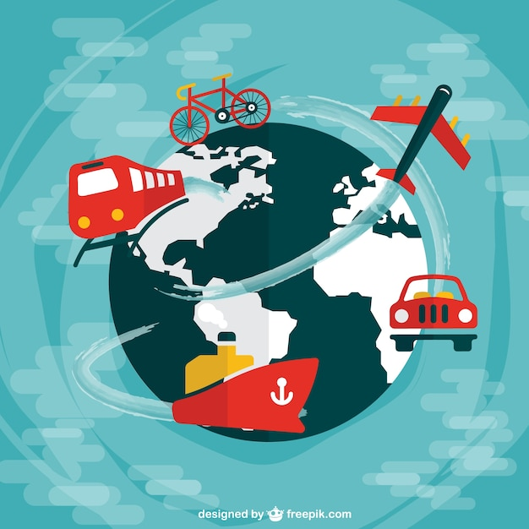
Means of Transport!!!!
(imagens freepik)

Slide 2
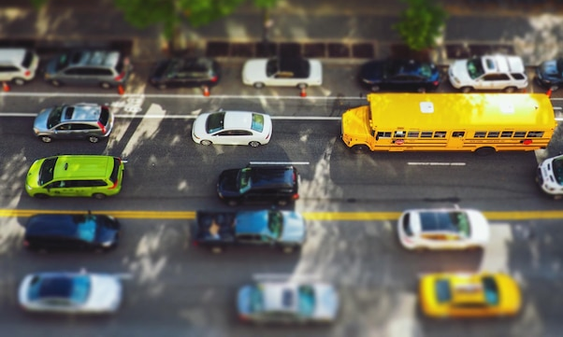
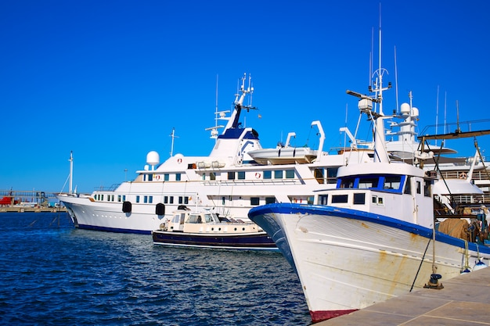
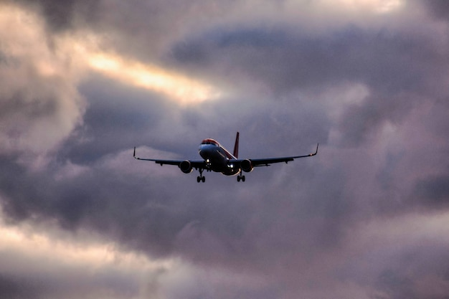
What are MEANS OF TRANSPORT?
Means of transport are the various ways in which people, goods and services move from one place to another (shorter or longer distances).
TRANSPORTS
In Land
In the Air
In Water
(imagens freepik)

Slide 3
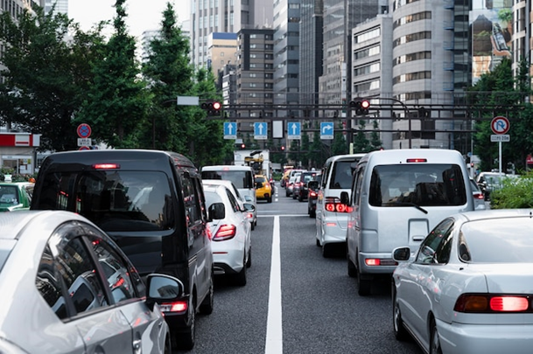
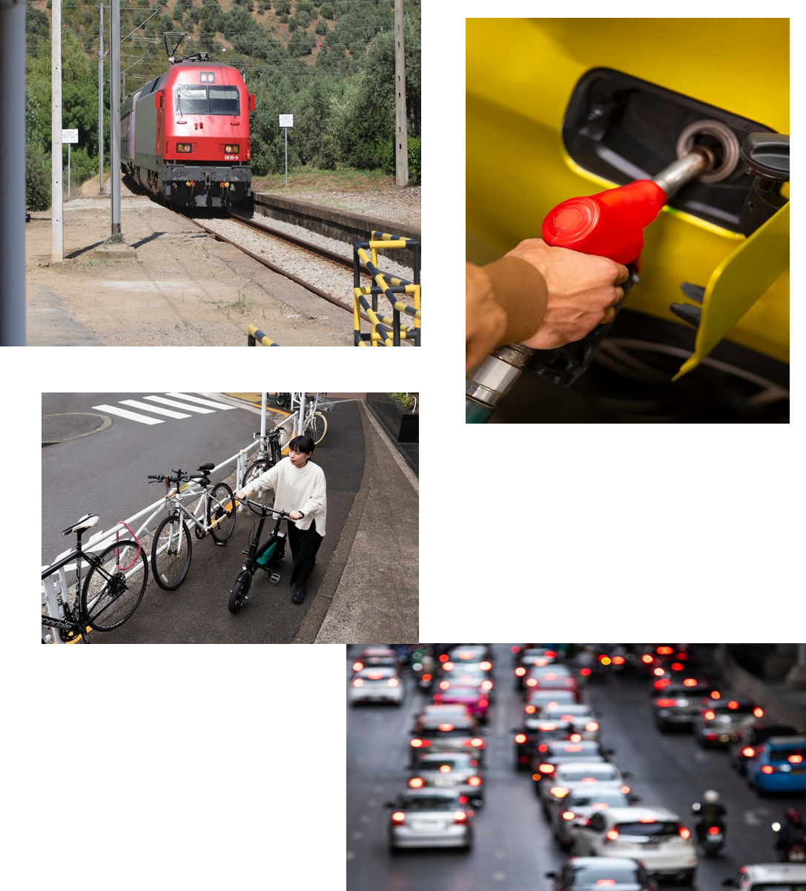
The means of transport can be divided in different groups:
          ROAD
          RAILROAD
Means of transport travelling on roads and land.
In LAND
They travel on land, on roads or on rails.
Means of transport travelling on the rails

Slide 4
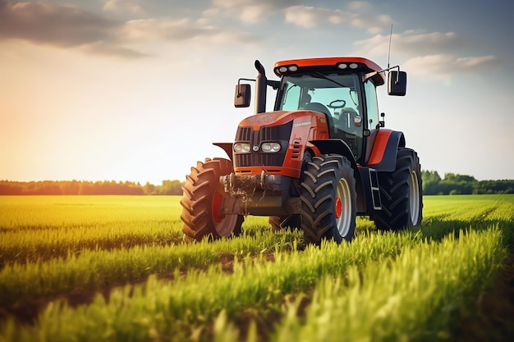
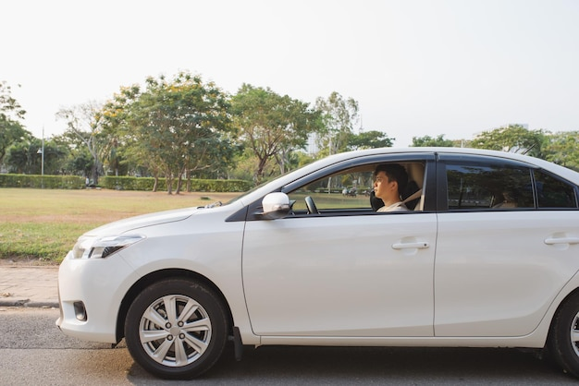
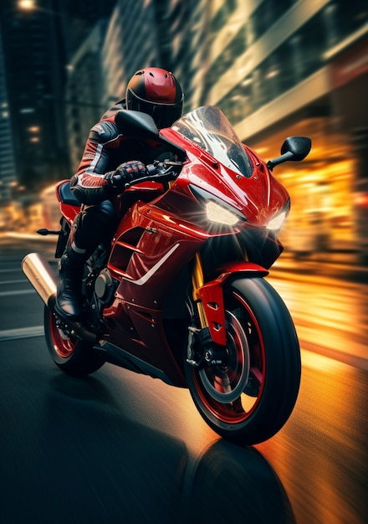
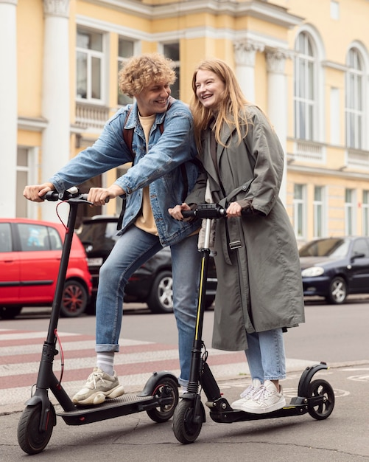
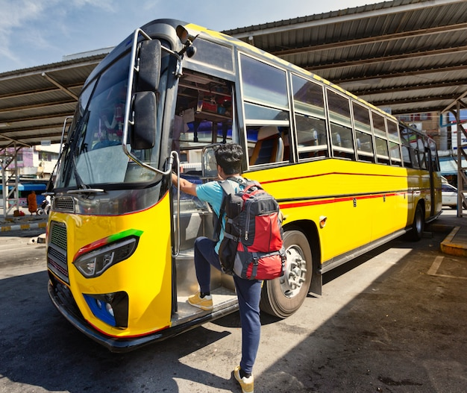
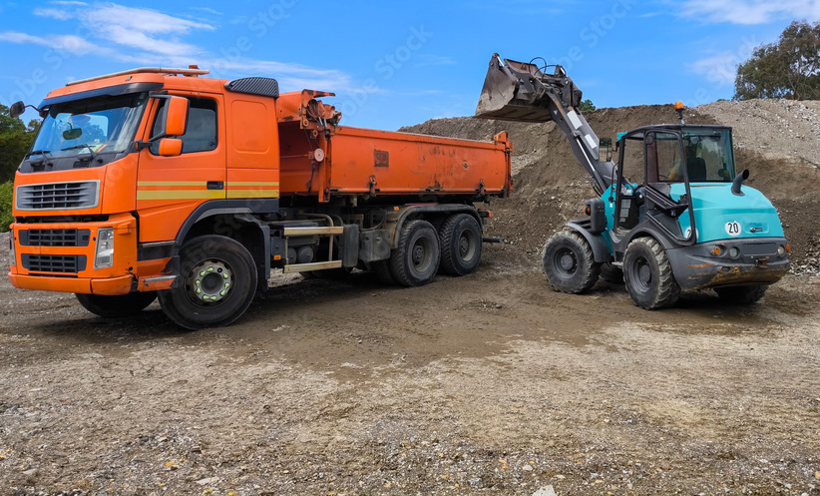
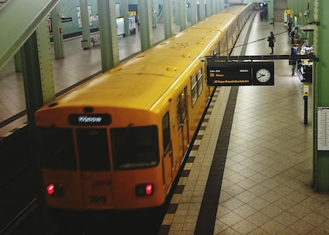
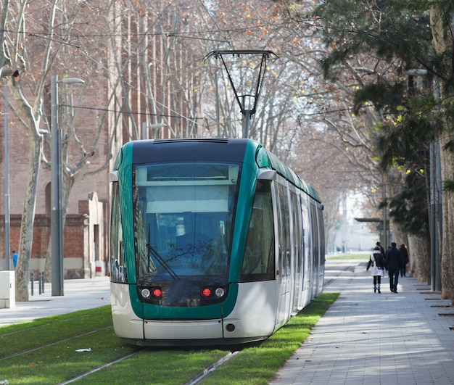
MEANS OF TRANSPORT IN LAND
          ROAD/MOTORWAY
          RAILROAD
(imagens freepik)

Slide 5
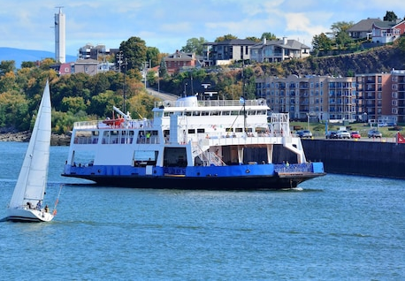
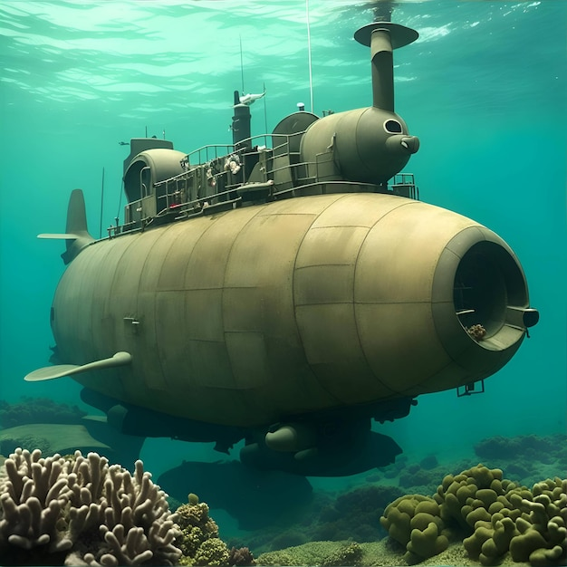
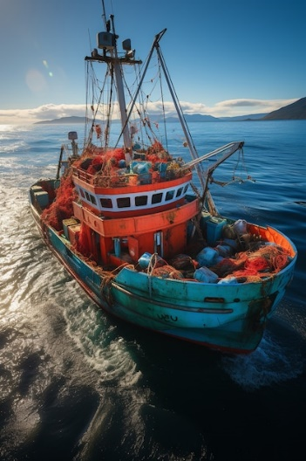
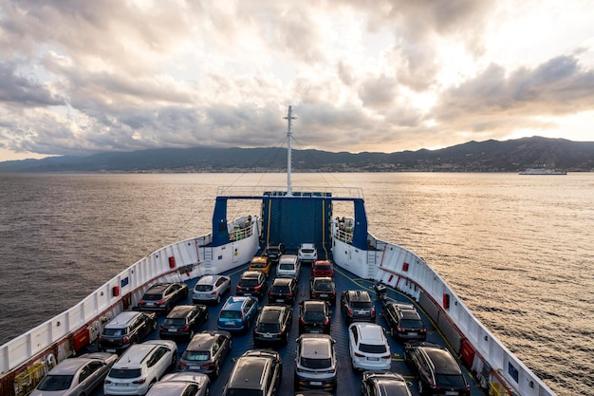
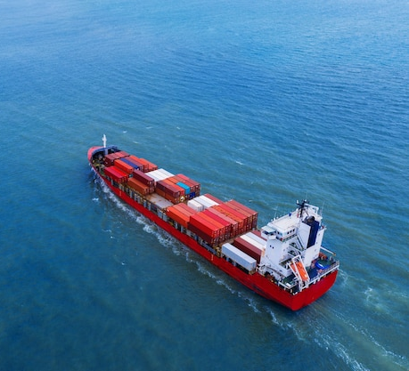
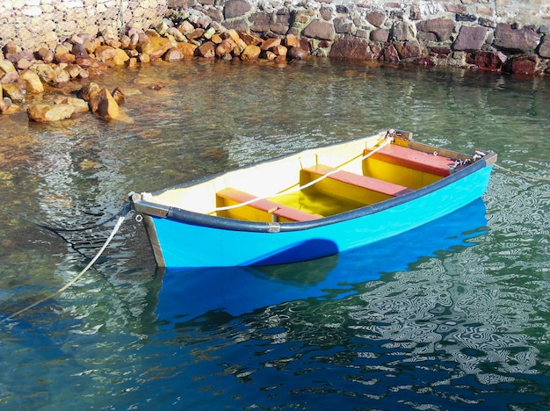
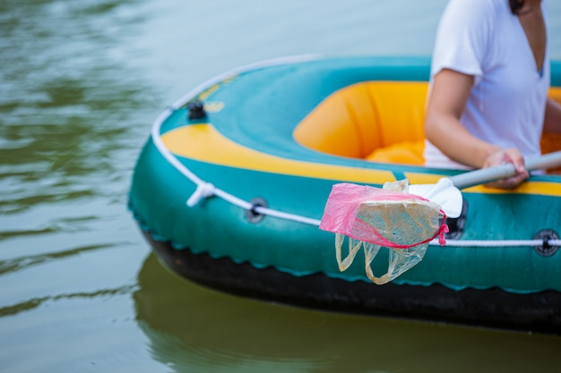
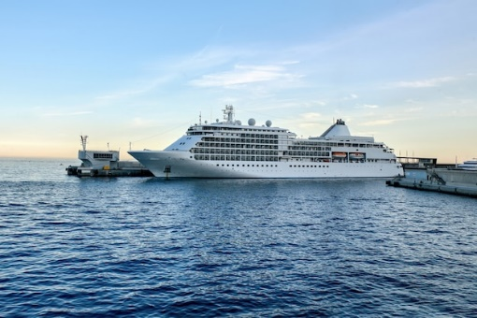
MEANS OF TRANSPORT IN WATER:
They move in the water:
Inland - Rivers and lakes
Marine - seas and oceans
Boat for transporting people across rivers.
Ferry boat
(Transporting cars)
Submarine
Fishing Boat
Freighter boat -
Transporting goods
(imagens freepik)
Rowing boats
Cruise ship - Transporting people

Slide 6
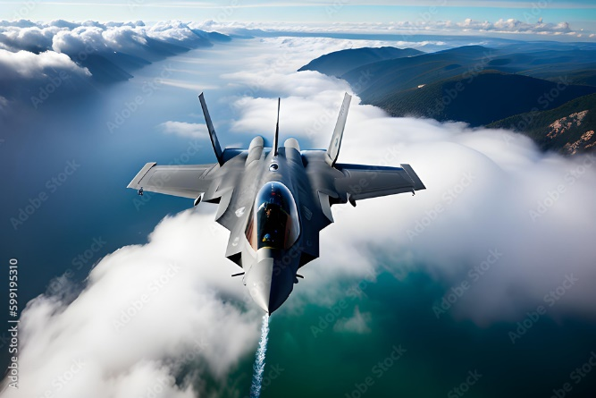
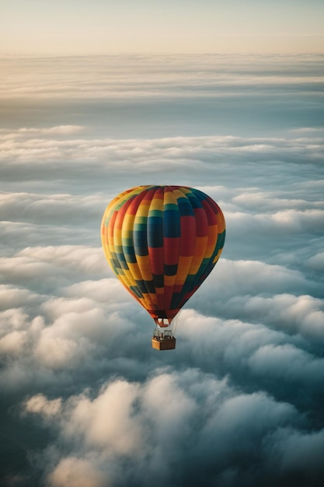
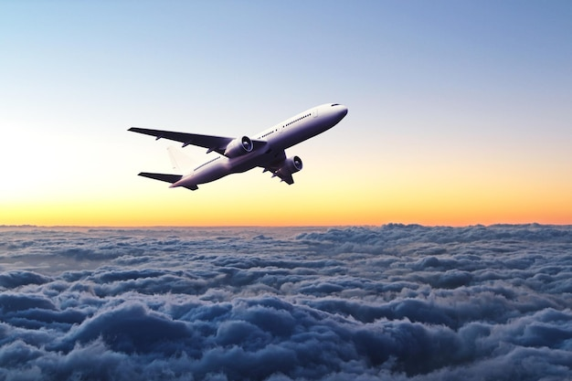
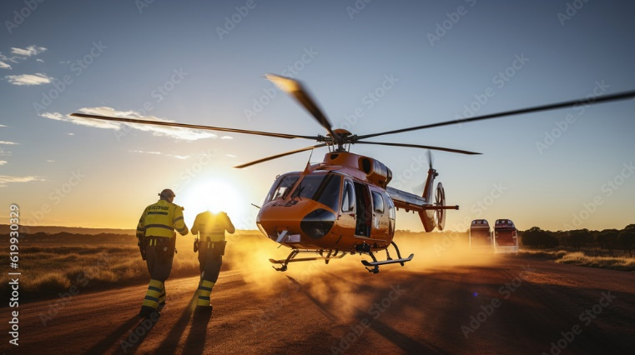
MEANS OF TRANSPORT: IN THE AIR
They move in the air.
(imagens freepik)

Slide 7







2022-1-BG01-KA220-SCH-000085065
Subject: Natural Science
Age of students: 7 – 8 years old
Topic: Nature
Resource Title: Means of Transport 1
Credits: AECE – Escola Básica da Zona Verde
All media are within the EU intellectual property law.
The European Commission’s support for this publication does not constitute an endorsement of the contents, which reflect the views only of the authors, and the Commission cannot be held responsible for any use which may be made of the information contained herein.

